Slide 1

CSCI 599: Content Detection and Analysis of Big Data : Class Activity
Presentation by:
Dhairya Pujara
Pavneet Kaur Mukar
Sachin Kumar GB
Sanjay Nadhavajhala
Vinita Thakur

Slide 2
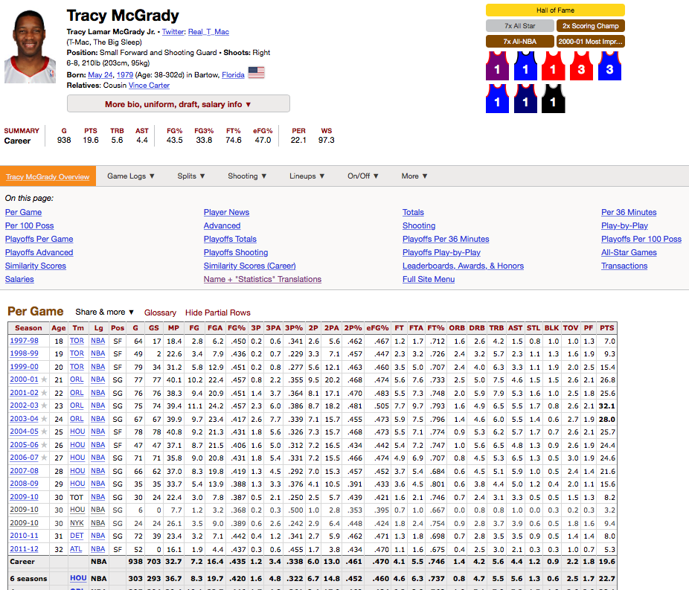
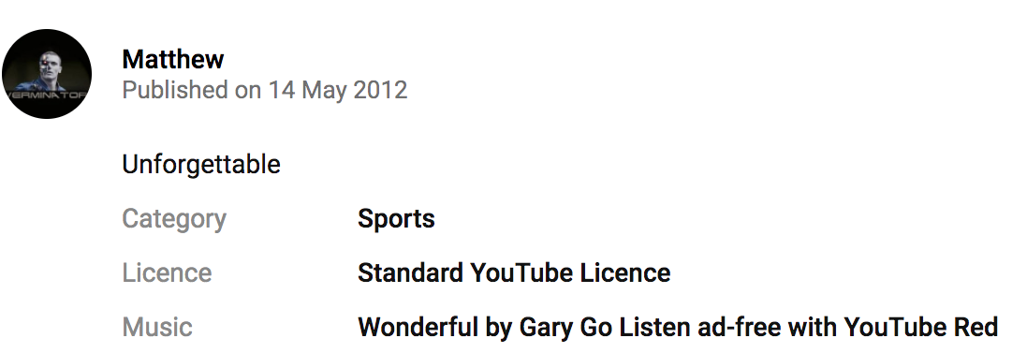
SPORTS
Mime Type | Metadata
 | Structural | Administrative | Descriptive
Text (Statistics data) | Player stats vs team stats, ordering of player profile (awards, statistics, news) | Creation time, Data rights | Player name, team, position, etc. (any keywords used in identifying a player/team)
Video | Quality, Subtitles |  | Highlights, Full match, Team, Date

Slide 3
LOGISTICS
Mime Type | Metadata
 | Structural | Administrative | Descriptive
Text | Table of contents | Creation time, copying and distribution limitation, Access limitations | Location, Date (Year Range)
Application | Based on type of service | Copyright date, file format, Access and Privileges | Title, Description

Slide 4
RESTAURANTS
Mime Type | Metadata
 | Structural | Administrative | Descriptive
Text (Reviews) | Reviews structured as per restaurants Photos structured as per reviews | Reviews are publicly available Date/Time of the review | Rating Cuisine Location Language
Application (json) | All possible keys | Menus are publicly available Big data administrator has access to customer data | Features Example (Customer name, date, dishes ordered)

